Slide 1
Sharing Our Common Home
Friday

Slide 2
Learning Objective
Students will be able to explain the term ‘sharing our common home’ and be able to understand the role we all play in creating one world with a common plan

Slide 3
keywords
Oppression
Sharing
Laudato Si’
Diakonia
Ecological Conversion
Common Good
Covenant
Dialogue

Slide 4
What is Laudato Si’ About?

Slide 5
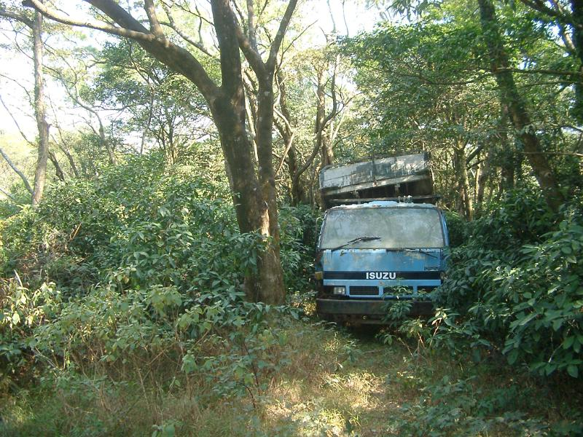
Group Discussion
In groups of no more than 4 students, discuss the following questions:
List concrete examples that illustrate Pope Francis’ statement ‘The earth, our home, is beginning to look more and more like an immense pile of filth’
Why do you think Pope francis would state ‘We Are Not God’ in Laudato SI’?

Slide 6
Laudato Si’
‘caress from god’ ‘Gift from God’
Challenge: ‘Examine our lifestyles’
What can we do to improve how we treat the world?
How can I show those I share the world with, how I cared for the world and tried to protect it?

Slide 7
Laudato Si’

Slide 8
Think – Pair – Share!
What alternative is offered to the burning of fossil fuels?
Explain the term ‘Ecological Conversion’. Reflect on what makes an ‘Ecological Conversion’ a ‘true conversion’
Do you think that viewing the world as a ‘sister with whom we share life’ changes how we would treat others and the world around us?

Slide 9
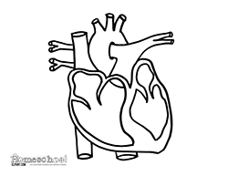
Reflective Exercise
Having watched the short video and discussed the questions above, what do you understand by the term ‘Conversion’. Try to work out the difference that a ‘change of mind’ can have versus a ‘change of heart’

Slide 10
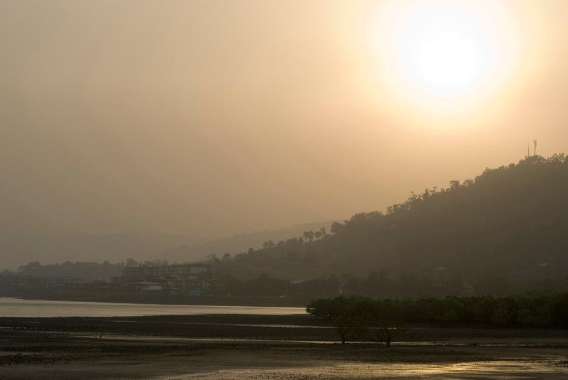
The Cry of the Earth

Slide 11
In the beginning, God created the heavens and the earth and God said ‘Let there by light’ (Book of Genesis)
‘I see his face in every flower; The thunder and the singing of the birds, Are but the voice – and carven by his power, Rocks are his written words’ (Joseph Mary Plunkett)
‘I see his blood upon the rose, and in the stars the glory of his eyes, His body gleams amid eternal snows, His tears fall from the skies’ (Joseph Mary Plunkett)
‘God saw that all God made was indeed very good. And God said: ‘I now establish my covenant with you and your descendants after you and with every living creature on earth.’ (Book of Genesis)
‘I draw to myself today, strength of Heaven, and glory of sun, brightness of moon, radiance of fire, swiftness of lightning, speed of wind, depth of the sea, stability of earth, firmness of rock… (St. Patrick’s Breastplate)
‘You love all that exists because your spirit is in all things.’
(Book of Wisdom)

Slide 12
Task
Students are invited to divide into the following groups:
Choose one of the quotes that appeared on the video and respond through the medium of either Art, poetry or drama
Group 1.
Art
Group 2.
Poetry
Group 3.
Drama

Slide 13
Extension Exercise
Take the quote from the book of wisdom. Investigate what this statement really means.
‘You love all that exists because your spirit is in all things.’
(Book of Wisdom)

Slide 14
Stewardship
God made us ‘stewards’ of his creation
Responsibility to both the physical world & the people in it
Common Good – that which is of benefit to us all

Slide 15
Stewardship
Rich countries consume more
BUT...
BECAUSE OF THIS
Poorer countries suffer more
=
OPPRESSION
If this process continues, there will not be a ‘Common Home’ to share!

Slide 16
Stewardship
Poorer Countries
Water
Food
Richer Countries
Water
Food
Shelter
'STUFF'
Shelter
This is called OPPRESSION!

Slide 17
Research Task
Using the trócaire website (ww.trocaire.org) research ‘Climate Justice’.
Group 1
Group 3
Group 4
Group 2
What is Climate Change?
What are the causes of Climate Change?
What are the effects of Climate Change?
What needs to change in Ireland with respect to Climate Change?

Slide 18
Numeracy Fact
Vatican City has the most solar power installed per capita (www.trocaire.org)

Slide 19
Challenging statement
‘The world is beginning to look more and more like an immense pile of filth’
Discuss: Do you think that environmental issues (e.g. climate change / loss of biodiversity) in our world are separate from social issues (e.g. Poverty / human trafficking) ?

Slide 20
Interdependence
We are ‘Interdependent’
‘Interdependence obliges us to think of one world with a common plan’
So…what is interdepence?

Slide 21
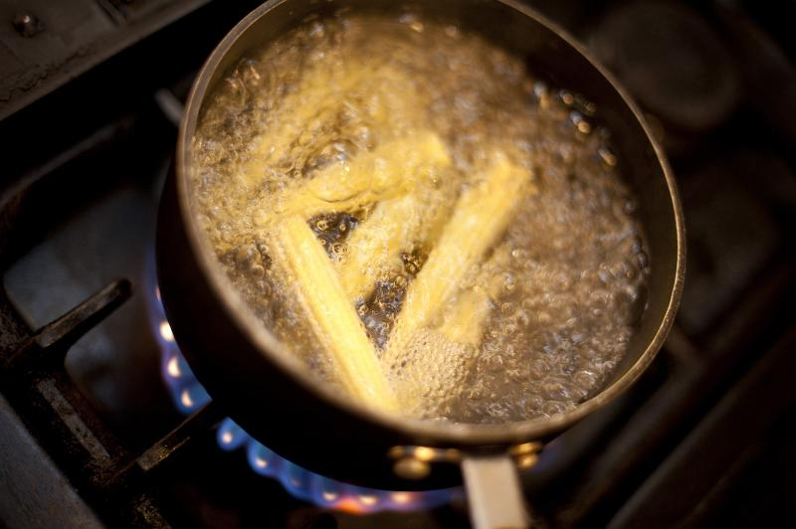
Think – Pair – Share!
Using a mind map, illustrate all the connections that John made when buying his corn!

Slide 22
Diakonia
We have been called to serve one another
Washing of the disciples’ feet
www.catholic.org

Slide 23
Task
Read Ephesians 4: 1-16
In order to become the body of Christ, in what ways should we show service for others? Having reflected on the ways in which we show service to others, do you think it would be a good ‘action plan’ for working towards ‘one world with a common plan’?
Give reasons for your answer
Are there any ways of showing service that you could add to this list?

Slide 24
Numeracy Moments
(1) If there are 100,000,000 different species on earth, and the extinction rate is 0.01% per year, how many different specifies become extinct each year?
(2) It takes 1,000 years to grow 1 metre of peat. In some places peat can measure about 12metres. Calculate how long it would take to grow this bog?
(3) National Agricultural Statistics show how a honey bee decline from about 6 million hives in 1947 to 2.4 million hives in 2008. Calculate the percentage reduction of bee hives during this time? (statistics from www.greenpeace.com )
(4) Of the 294 locations suitable for cultivating cacao in Ghana, only 10.5% of these will be suitable by the year 2050. Calculate the number of locations that will be suitable for cultivating cacao by 2050. (statistics from www.climate.gov )

Slide 25
Task Which to save? Taken from ‘Creating Future Resources’ www.trocaire.org
Imagine a gas had been released into the atmosphere that is deadly for seven different parts of nature. These parts of nature are: Salmon, Rice Plants, Polar Bears, Bees, Irish Bogs, Coral Reefs and Cocoa Trees. There is an antidote for the gas which will stop the gas killing these parts of nature. However, there is not enough of the antidote. You have to decide which part of nature should be saved.
Salmon | Rice Plants | Polar Bears | Bees | Irish Bogs | Coral Reefs | Cocoa Trees
Reasons for Saving | Reasons for Saving | Reasons for Saving | Reasons for Saving | Reasons for Saving | Reasons for Saving | Reasons for Saving

Slide 26
Laudato Si’ 202
‘We lack an awareness of our common origin, of our mutual belonging, and of a future to be shared with everyone.’
Conversion – change of attitude…a change of heart
Ooooo…the possibilities

Slide 27
Reflective Exercise
Take a photo or pick an image that you would use as the front of a postcard. Address the postcard to your future grandchildren. Do not write any message on the postcard. The photograph / image needs to show that, in your life, you did your best to care for our common home and you want to share this with your grandchildren.
Unless otherwise stated, Images: www.freeimages.co.uk

