Slide 1
From generation to Generation
Wednesday

Slide 2
Learning outcomes:
Students will be able to explain, and give examples of intergenerational solidarity, especially in the area of water, as discussed in Laudato ‘Si.
Optional: they will take action in one specific area, the use of bottled water, and donate whatever they save to Trócaire.

Slide 3
Keywords
Solidarity
Mercy
Waste
Intergenerational
Family
Compassion
Environment
Water

Slide 4
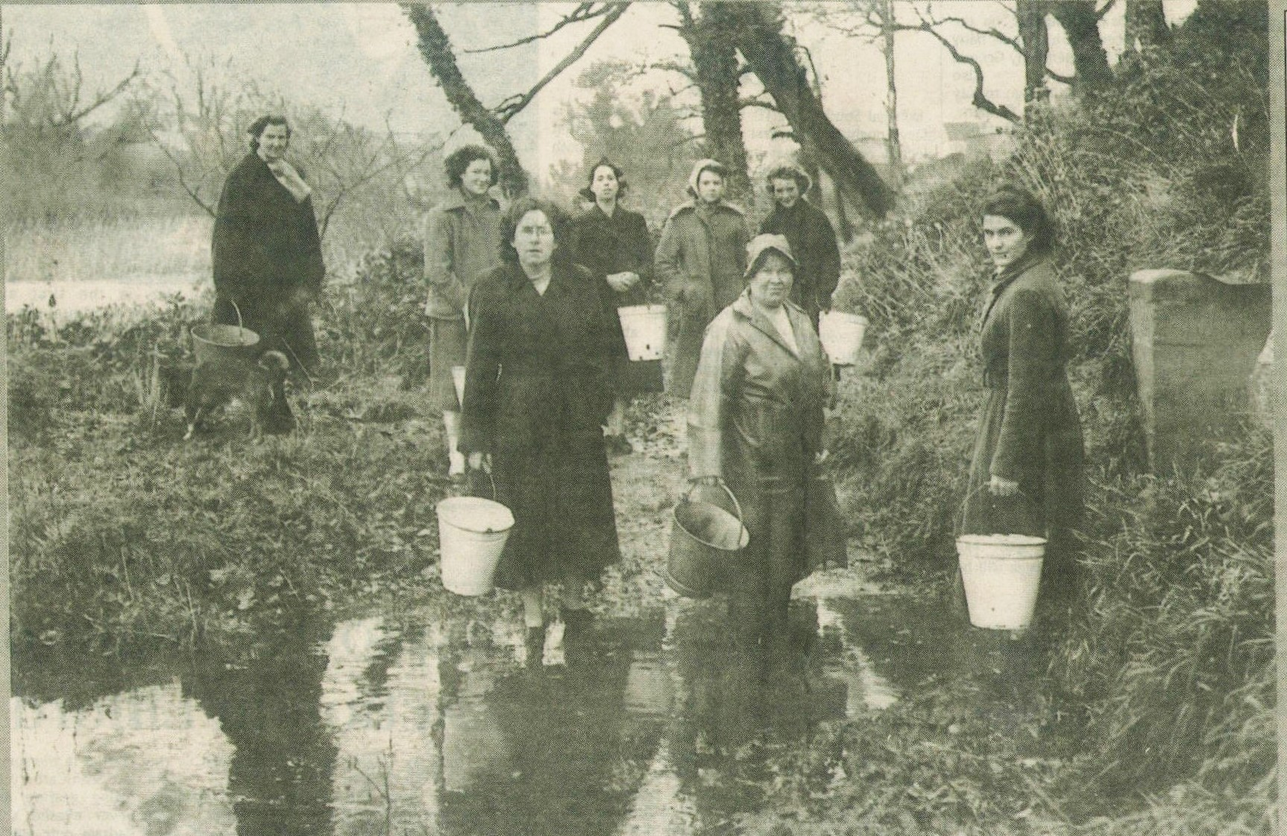
Photo Credit: George McCready, published in Donegal Free Press, February 24th, 1999.

Slide 5
Think – Pair - Share
1. In what decade do you think this picture was taken?
2. What do you think is going on?
3. Do you notice anything about the gender of the people in the photo?
4. Do you know anyone who collected water from the well in her youth?

Slide 6
Numeracy Moment
If an average person in Ireland uses 150 litres a day, how many trips to the well would it take if you have an twenty litre bucket?
Do you think your grandparents or great grandparents’ generation used less water because they might have had to fetch it by hand?
Could you talk to an older relative, perhaps a grandparent, to ask them about how they used water, and how they see water being wasted today?

Slide 7
Fact
A young person in Malawi uses about 24 litres of water a day and girls & women spend about four hours a day fetching water

Slide 8
Water usage in the developing world -Trócaire

Slide 9
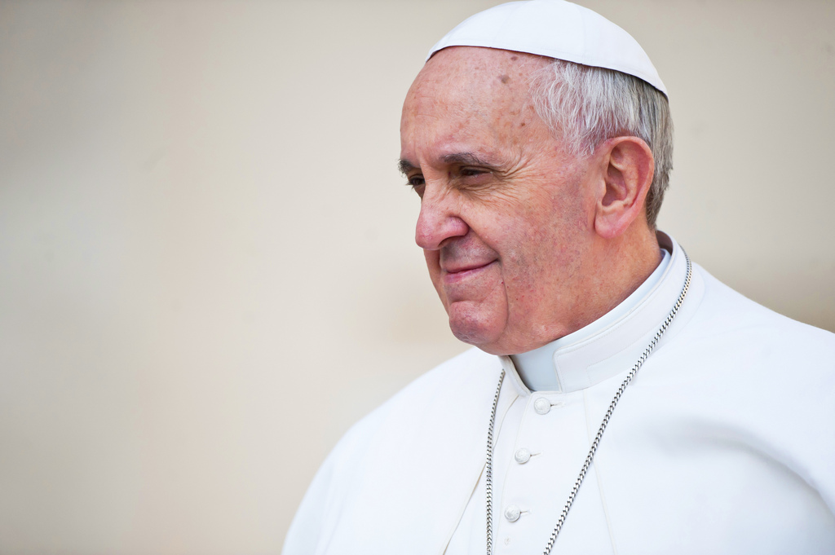
Pope Francis mentions the word water 47 times in
his Encyclical on the environment, Laudato ‘Si.
Why do you think
he mentions it
so often?
Source: Flickr Creative Commons license

Slide 10
The Issue of Water
We all know that it is not possible to sustain the present level of consumption in developed countries and wealthier sectors of society, where the habit of wasting and discarding has reached unprecedented levels. The exploitation of the planet has already exceeded acceptable limits and we still have not solved the problem of poverty. Laudato ‘Si 27
? Question ?
Can you give examples of waste when it comes to water?

Slide 11
Laudato Si’ - The Issue of water
We can no longer speak of sustainable development apart from intergenerational solidarity. Once we start to think about the kind of world we are leaving to future generations, we look at things differently; we realize that the world is a gift which we have freely received and must share with others. ... Intergenerational solidarity is not optional, but rather a basic question of justice, since the world we have received also belongs to those who will follow us. … What kind of world do we want to leave to those who come after us, to children who are now growing up? (Laudato ‘Si 159, 160)

Slide 12
Activity
(1) What does ‘intergenerational solidarity’ mean?
(2) How might ‘Intergenerational Solidarity relate to water use?
(3) How might pope Francis’ view on intergenerational solidarity relate to the image and quote on the next slide?

Slide 13
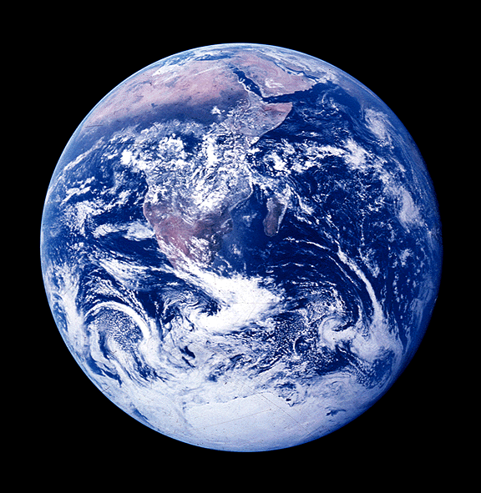
Treat the earth well – it is not inherited from your parents: it is borrowed from your children.
Kenyan Proverb
How does this relate to what the Pope is saying in Laudato ‘Si?
Source of image:Flickr: Creative Commons license
Notes:
Source: Miracc Flickr Creative Commons License
http://bit.ly/2fClFyt

Slide 14
Water in our world – Trócaire

Slide 15
DIscussion
Did you realise that the amount of water on the planet is finite?
What can you do in a concrete way to reduce wastage of water?

Slide 16
What does ‘intergenerational solidarity’ mean in relation to water use?
Source: Trocaire infographic – See the whole thing here: https://www.trocaire.org/sites/trocaire/files/education/lent2014/infographic.pdf

Slide 17
Ireland – July 2015 July 2016 €76.5m on bottled water…€15.30 per head
3 litres water = 1 litre bottle of water
1,000 years = 1 bottle to biodegrade
Impact of Bottled Water
3 million tons plastic bottles = dumped into landfill Every day
(US alone = 30 million water bottles a day dumped in landfill)
1 litre bottled water – emits 300 times more greenhouse gasses that a litre of tap water
17 million barrels of oil – to satisfy us water market…enough fuel to keep ½ of Ireland’s 2,000,000 cars motoring for a year!
Amount we spend of bottled water = eradicate the deaths of all children infected with fatal waterborne illnesses
W.H.O. – 1.6million people in developing world…die of water contamination (vast majority = children under 5)
Source: Conor Pope, Irish Times, The Hidden Costs of Drinking Bottled Water, August 22nd, 2016

Slide 18
Numeracy Moment
What is the average amount spent on bottled water annually?
Do you think your own consumption is greater or lesser?
Where do the additional costs come from in relation to bottled water? Think of it like a product. What do products need when being manufactured, being transported and so on?

Slide 19
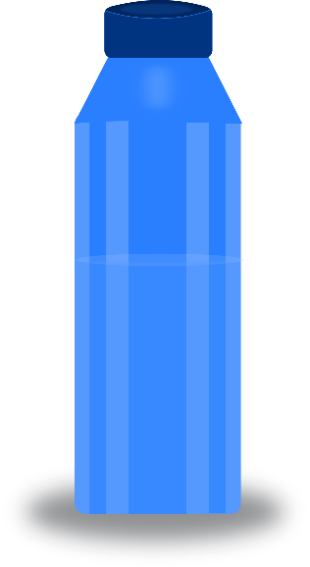
Challenge!
Take the water bottle challenge: Don’t just flip the bottle, ditch it!
As a class, try to use drink only tap-water and to use recyclable bottles, even if only for a week.
Estimate how many plastic bottles a year this will save.
Donate the money you would have spent to Trócaire
Open clipart
Gsagri04 Creative Commons

Slide 20
Reflective Exercise
Would you consider giving up using bottled water completely?

Slide 21
Activity
Water is one of the most important symbols in Christianity. Copy the mind map into your religion journal and provide further examples from the bible, Liturgical worship or the lives of the irish saints. This exercise should be completed in pairs.

Slide 22
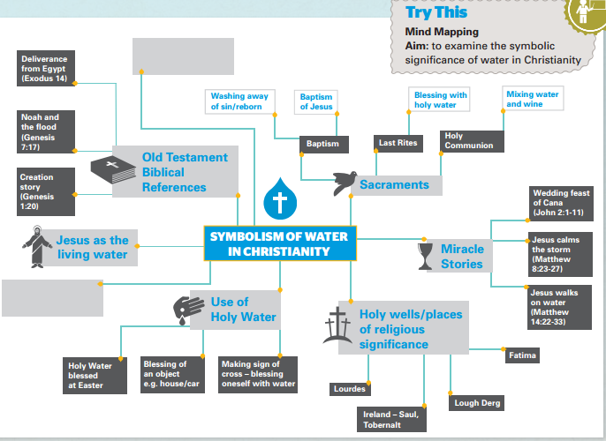
Image courtesy of Post-Primary Resources – Make Every Drop Count (www.trocaire.org)

